Slide 1

Capstone Project – Telecom Churn
Using Logistic Regression
By A.R. Premkumar

Slide 2
BUSINESS OBJECTIVE
In the telecom industry, customers are able to choose from multiple service providers and actively switch from one operator to another. In this highly competitive market, the telecommunications industry experiences an average of 15-25% annual churn rate. Given the fact that it costs 5-10 times more to acquire a new customer than to retain an existing one, customer retention has now become more important than customer acquisition.
For many incumbent operators, retaining highly profitable customers is the number one business goal.
To reduce customer churn, telecom companies need to predict which highly profitable customers are at risk of churn.
The goal is to develop a model to predict customers who are likely to Churn

Slide 3
SOLUTION METHODOLOGY
D a t a C l e a n i n g a n d m a n i p u l a t i o n
E x p l o r a t o r y D a t a A n a l y s i s
M o d e l B u i l d i n g
M o d e l E v a l u a t i o n
M o d e l P r e d i c t i o n o n Te s t s e t
I n f e r e n c e s
R e c o m m e n d a t i o n

Slide 4
DATA CLEANING
There are 226 columns with high number of missing values and since we have around 99999 data points we can eliminate the columns that are less relevant to this project;
We dropped mobile_number, circle_id, columns that end with “-9”, since they are of no use to us;
Columns like 'loc_og_t2o_mou', 'std_og_t2o_mou', 'loc_ic_t2o_mou', 'last_date_of_month_6’, etc., which has unique values of 0s and 1s which are of no use;
Filled Nan values with zeros on columns like date_of_last_rech_data_9, date_of_last_rech_data_6, date_of_last_rech_data_8, date_of_last_rech_data_7, av_rech_amt_data_6, fb_user_6, total_rech_data_6, et.
Identified high collinearity between columns and deleted columns 'arpu_2g_6', 'arpu_2g_7', 'arpu_2g_8', 'arpu_2g_9', 'arpu_3g_6’, etc.
Add column 'Avg_arpu_67’ by taking avg of columns 'arpu_6’ & 'arpu_7’, and deleted both columns 6 & 7.

Slide 5
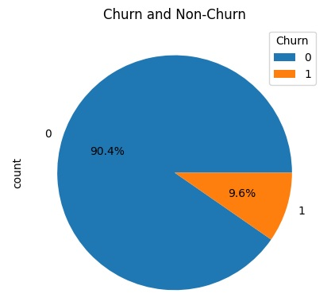
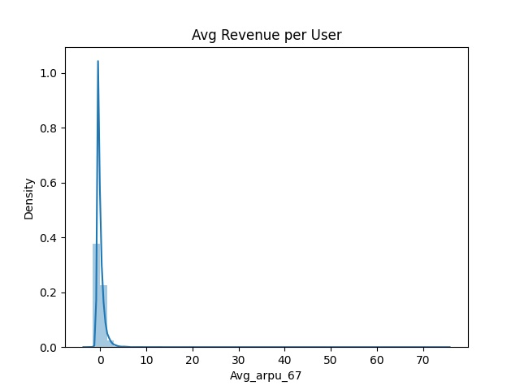
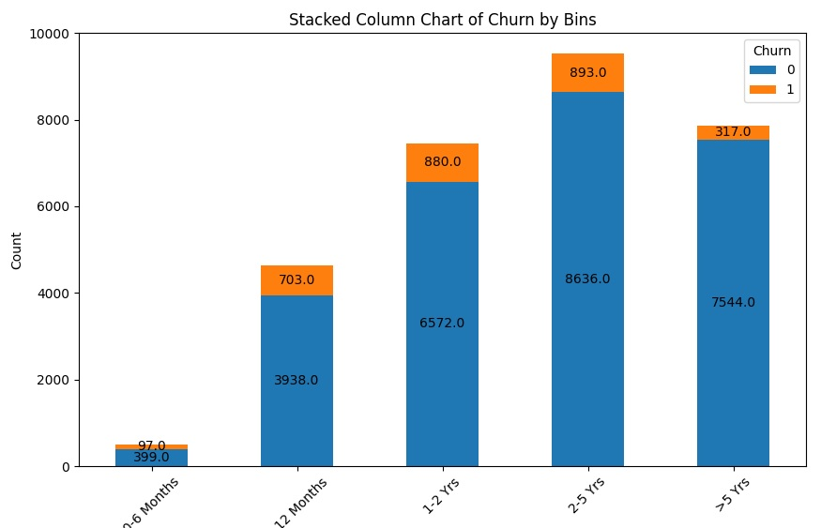
UNIVARIATE ANALYSIS
Churn Count
Average Revenue per user Months 6 & 7
Churn vs Non-Churn
Definitely there’s class imbalance in Churn and Non-Churn counts. This is tackled using SMOTE before logistics regression.
Avg Revenue per user for the good phase of months 6 & 7 has been arrived to identify the probability density function.
Its evident that customer retention grows stronger over long duration. In other words, the Churn rate is high in first 6 months.

Slide 6
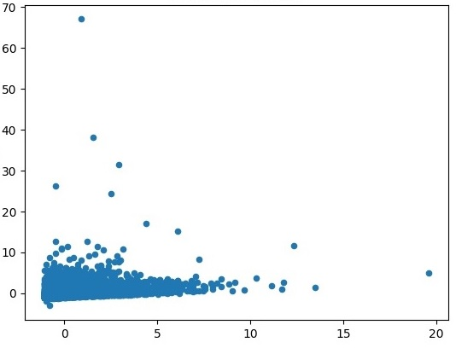
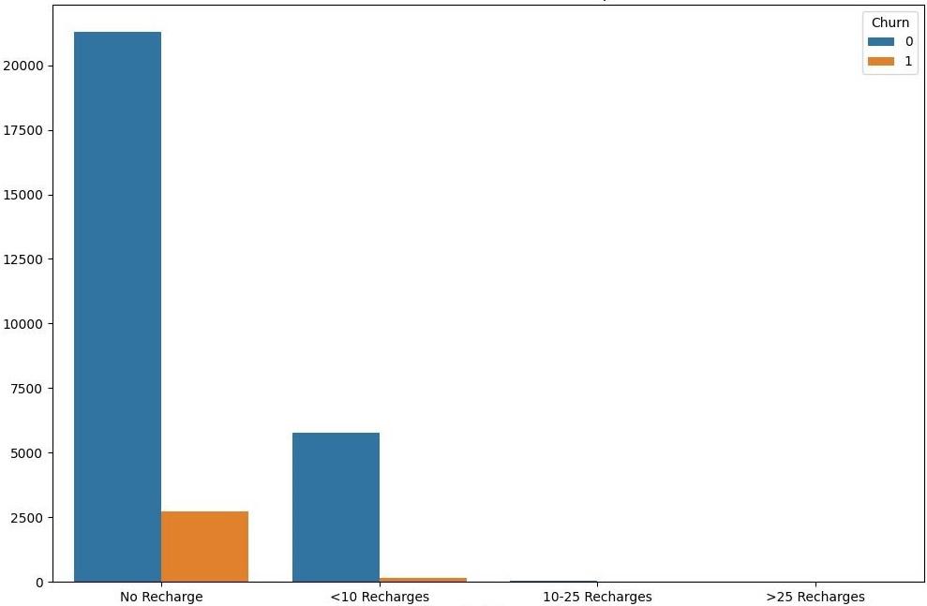
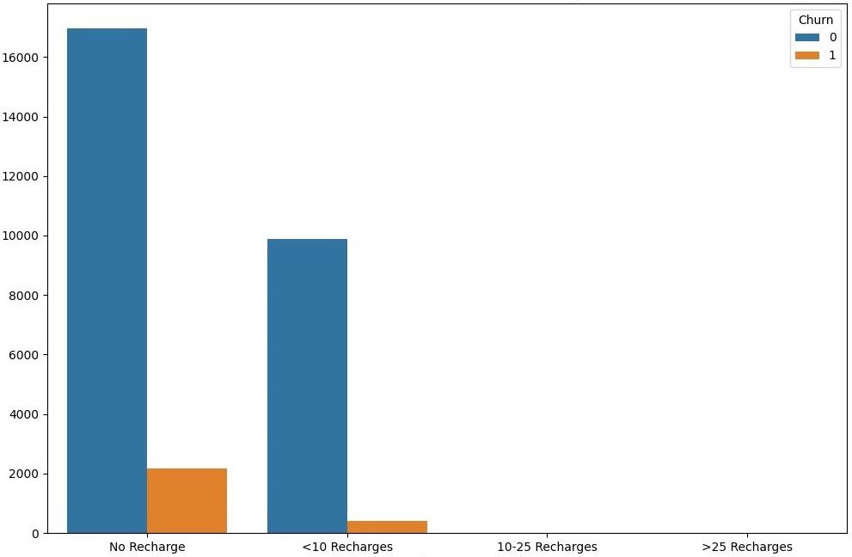
BI- VARIATE ANALYSIS
Avg Revenue vs Total Reach
Total Reach Data vs Data Group
Total Reach Number vs Number Group
Avg Revenue in the action phase of 8th month is positively correlated with Total Reach
Total recharge in the action phase of 8th month has high correlation with Churn Rate
Total Reach Number in the action phase of 8th month has high correlation with Churn Rate

Slide 7
MODEL BUILDING
Slitting the data into train and test split with 70:30 ratio
Scale numerical feature using MinMax scaler
Use Recursive feature Elimination (RFE) to identify 20 most important feature
Use p-value and Variance inflation factor to eliminate statistically insignificant features
Finally, we ended up with 19 features for the model

Slide 8
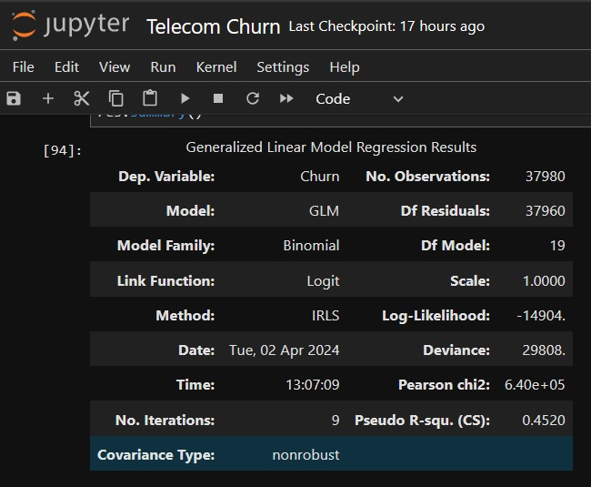
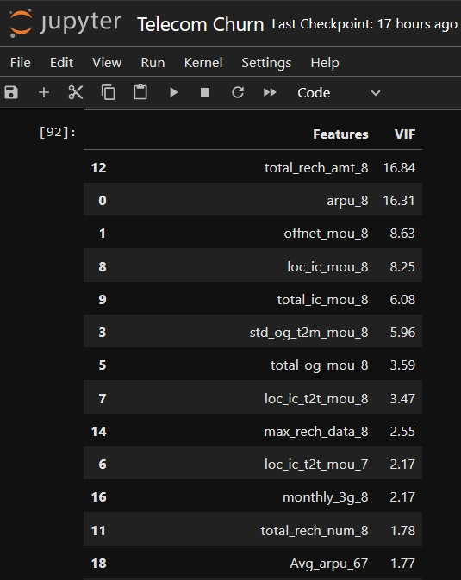
MODEL EVALUATION

Slide 9
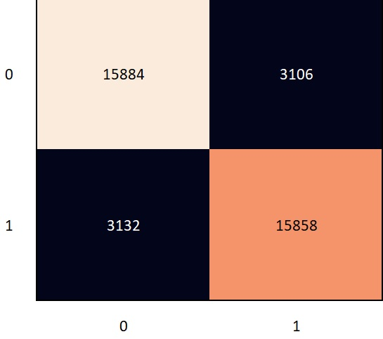
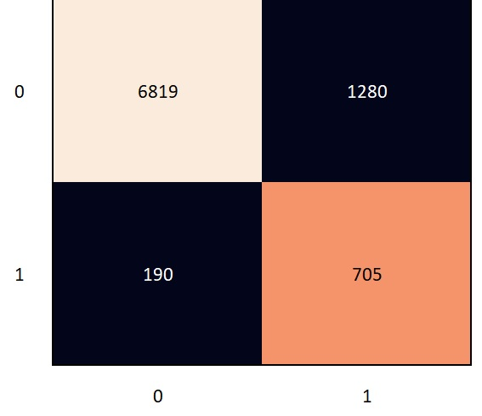
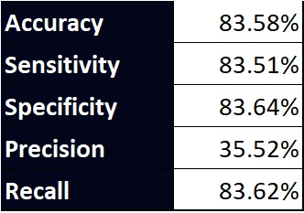
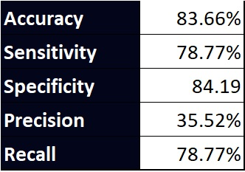
MODEL EVALUATION
T R A I N I N G S E T
T E S T S E T

Slide 10
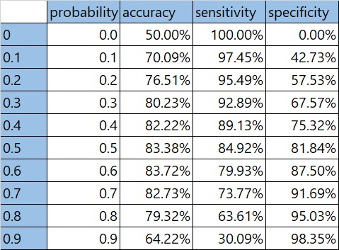
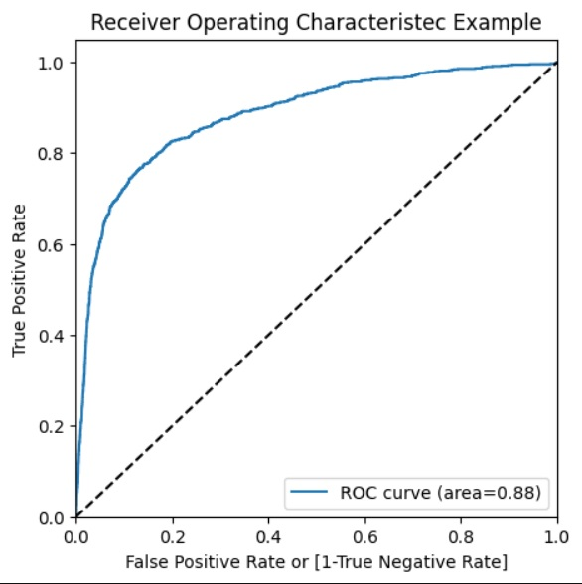
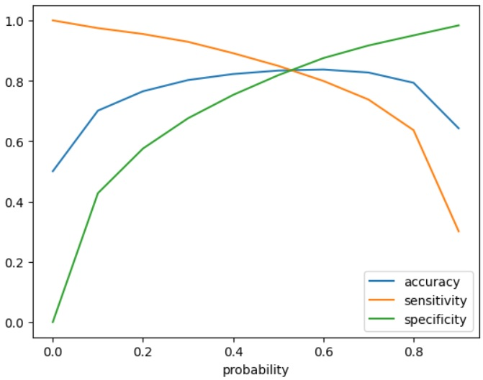
MODEL EVALUATION - ROC/ CUTOFF

Slide 11
INFERENCES
Top three variables in your model which contribute most towards the probability of a customer getting churned
Age on Network ‘aon’,
Total Reach Data ‘total_rech_data_9’,
Total Reach Num Group ‘total_rech_num_9’
Top categorical/dummy variables in the model which should be focused the most on in order find the maximum probability of Churn
'total_rech_data_group_8'
'total_rech_num_group_8'

Slide 12
RECOMMENDATION
Depending on the requirements the model needs to be tweaked such that
New clients are more likely to churn
Clients with higher Monthly Charges are also more likely to churn
Tenure and Monthly Charges are probably important features
Customers with the first 4 additional services (Security, Backup, Protection, Tech support) are less likely to churn
Streaming services are not likely to associate with churn
Marketers should be careful with the tradeoff between precision and recall.
We recommend future tuning out prediction model before we offer discount to retain customers.
Limited Data (7,043 observations with 26 variables)
Imbalanced Data (26.54% of churned customers)
Bias: a point in time
More features and more data to train model
Not possible to retain high precision when aiming high recall

Slide 13
Thank You

